Slide 1
Customer Churn Prediction Model
BAN6800 – Module 4 Assignment
Prince Nsidibe

Slide 2
Introduction
Churn prediction is critical for business analytics.
Objective: Develop predictive models (Logistic Regression, Random Forest) to identify potential churners from customer dataset (Experts, 2025).

Slide 3
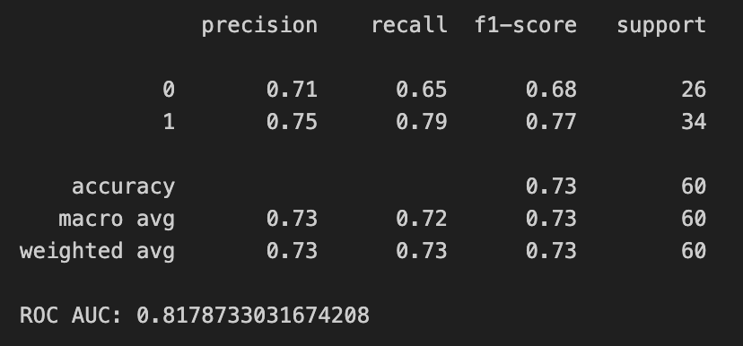
Data Preparation
Source: Finalized churn dataset from Milestone 1
Key preprocessing steps:
Handled missing values
Standardized numeric features
One-Hot Encoded categorical variables
Balanced dataset using SMOTE

Slide 4
Modeling Approach
Models built:
Logistic Regression (Lee, 2025).
Random Forest with hyperparameter tuning (Koehrsen, 2025).
Train-test split: 70% training, 30% testing
Evaluation metrics: Accuracy, Precision, Recall, F1-score, ROC-AUC

Slide 5
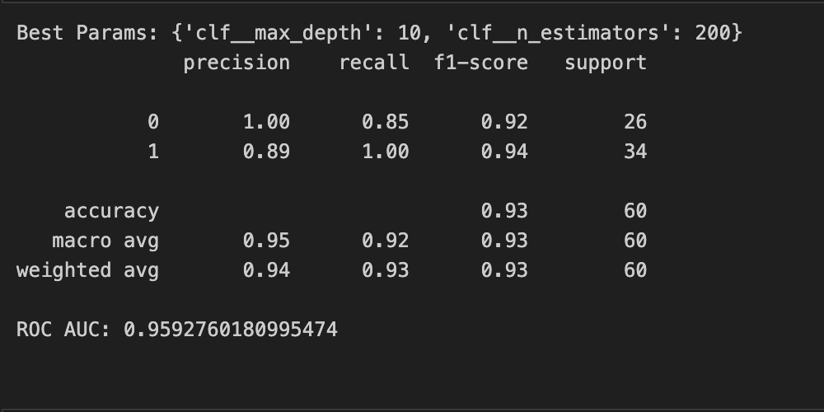
Logistic Regression Results
Summary of classification report.
Strength: Easy, interpretable coefficients.
Weakness: The recall has been slightly lower than in Random Forest.

Slide 6
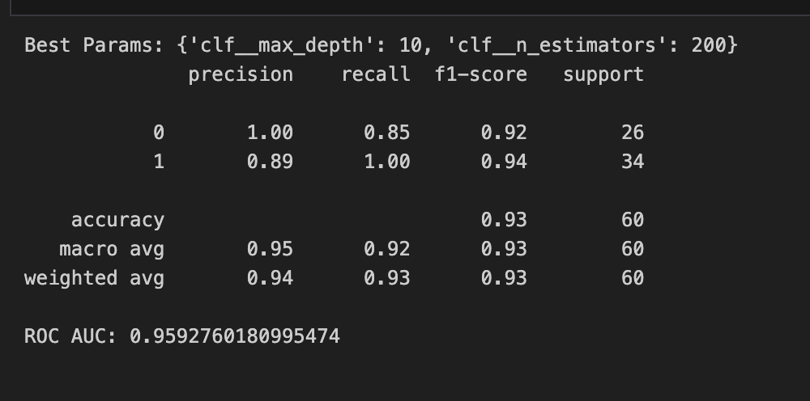
Random Forest Results
GridSearchCV tuned parameters: n_estimators, max_depth
ROC-AUC is higher compared to Logistic Regression
Stronger recall → better for churn detection

Slide 7
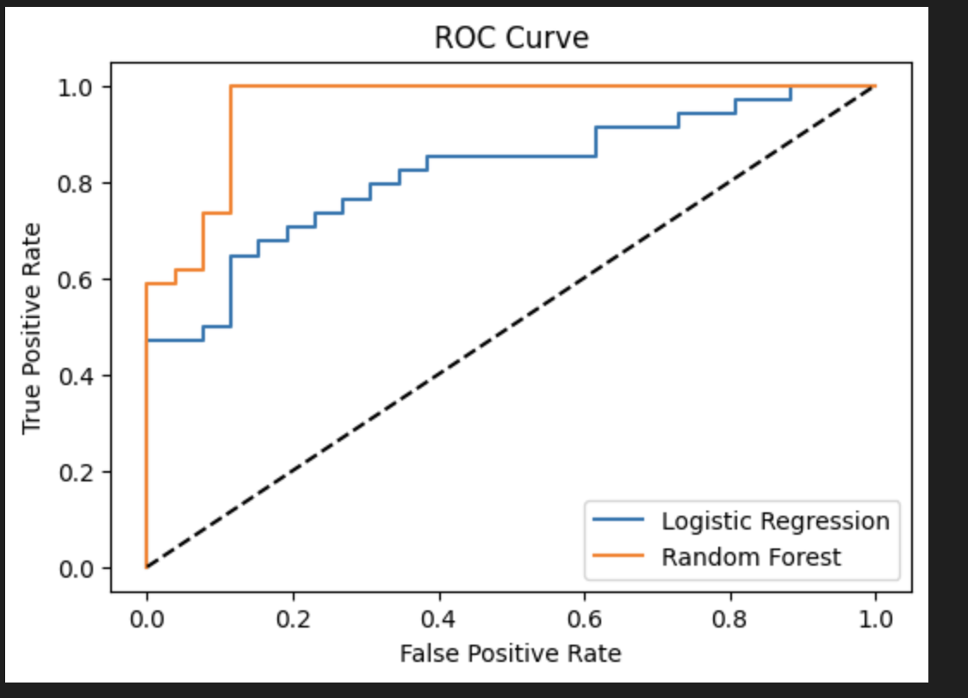
ROC Curve Comparison
ROC curves compared for both models
Random Forest outperforms Logistic Regression

Slide 8
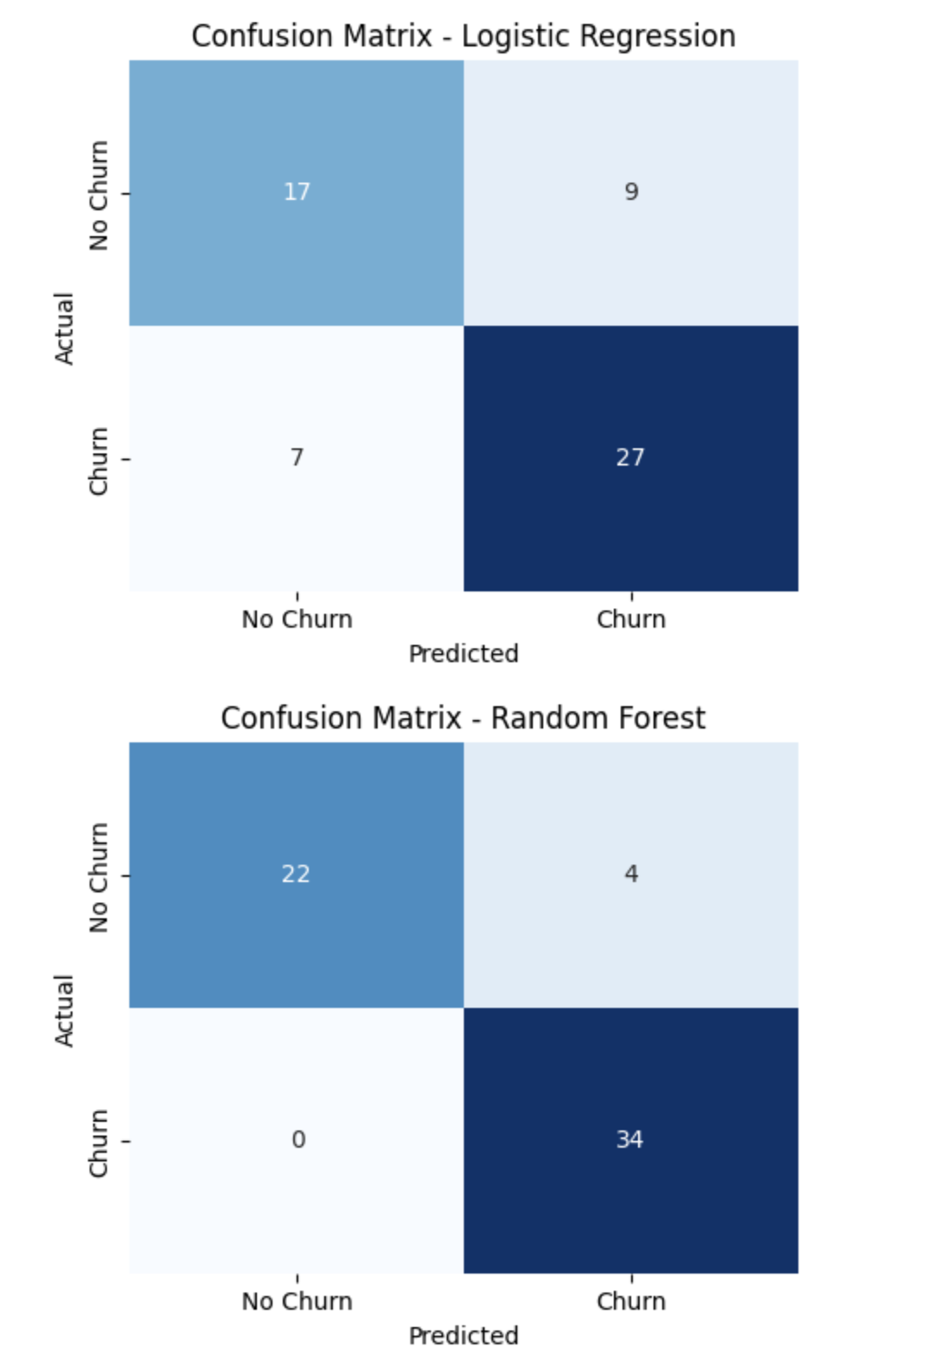
Confusion Matrix
• Example: Random Forest confusion matrix
• Explains False Positives vs False Negatives in churn context

Slide 9
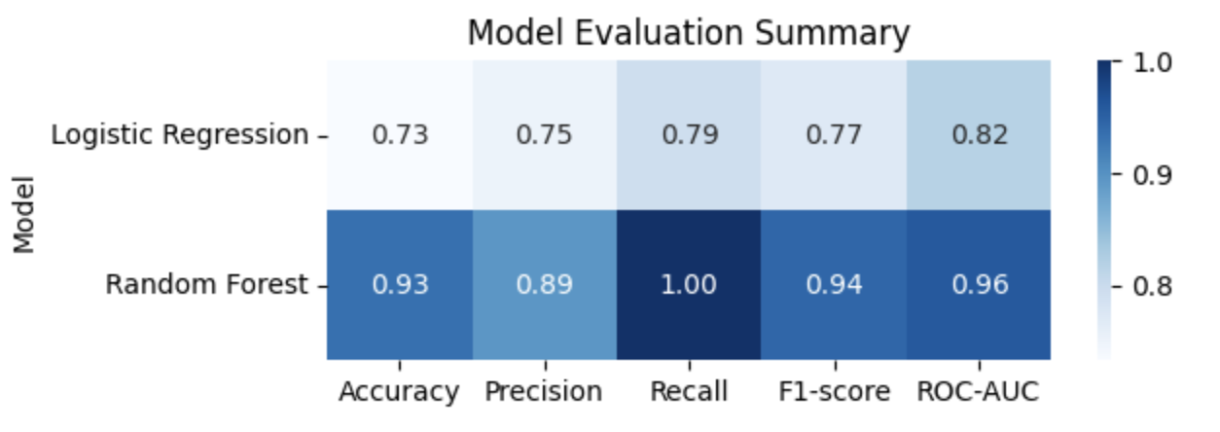
Model Evaluation Summary

Slide 10
Business Insights
The less engaged and tenured customers are subject to higher churn.
Churn rate can be decreased by targeted retention campaigns.
The Random Forest model is suggested for deployment.

Slide 11
Ethical Considerations
Bias: Ensure fairness across demographics
Privacy: Respect customer data security
Transparency: Logistic Regression easier to explain, but RF more accurate

Slide 12
Conclusion
Both models are effective → Random Forest is better overall
Next steps: Deploy model as a monitoring tool, retrain periodically
GitHub repository: [Insert your repo link here]

Slide 13
references
Lee, F. (2025, September 16). What is logistic regression. ibm. https://www.ibm.com/think/topics/logistic-regression
Koehrsen, W. (2025, March 6). Hyperparameter tuning the random forest in Python. Towards Data Science. https://towardsdatascience.com/hyperparameter-tuning-the-random-forest-in-python-using-scikit-learn-28d2aa77dd74/
Experts, D. (2025, May 22). Churn prediction. DealHub. https://dealhub.io/glossary/churn-prediction/

